Slide 1
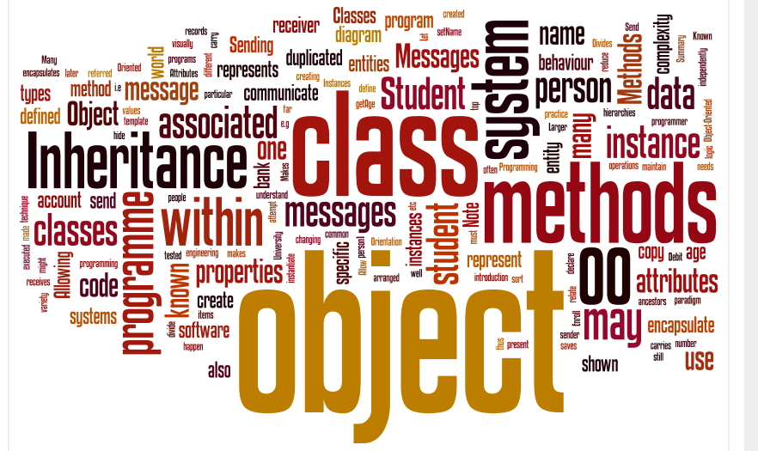
3 Object Oriented Programming
Neil Urquhart

Slide 2
1 Introduction to Objects

Slide 3
Object Oriented Programming
Object-Oriented programming is an attempt to reduce program complexity.
encourages code re-use
Divides systems into objects
Objects represent different entities within the system
Notes:
123-124

Slide 4
Objects
Our objects are normally based on real-world entities within the system we are modelling
Objects can encapsulate data or attributes associated with that object – known as properties
Objects can encapsulate logic associated with that object – known as methods

Slide 5
A Person Object
This is how we visually represent an object
Note the object name is shown at the top
Properties are shown within the object
This represents a particular person called “person1”
Note that so far we have no methods associated with our person
person1
name
age
address
Notes:
123-124

Slide 6
More people objects
Each individual person will have their own values associated with their properties.
person1
person2
name = "John"
age = 21
address = "High Street"
name = "Sian"
age = 25
address = "Up Town"
Notes:
123-124

Slide 7
Methods
An object has methods that define the behavior of the object.
Methods are a set of instructions that define a specific task
Methods are often executed in response to a message received from another object
They may themselves send another message (or a response) to an object
Methods are frequently used to update or share property values
Operations for a Person object might be getName, setName, getAge etc.

Slide 8
Methods
Allow a class to carry out tasks such as
Enroll a student
Debit a bank account
Credit a bank account
Normally made up of program code that can
Send messages to other classes
Modify the class properties
Notes:
95-96

Slide 9
Methods
Here is a student object ...
student
name = "Jim"
programme = "Computing”
matriculate()
graduate()
Our object has two methods
matriculate()
Graduate()
These are both methods that a student needs
Notes:
124-125

Slide 10
Classes
OO software will often use more than one copy or instance of an object
e.g. a University records system will have many Student objects
Each instance is referred to as an object
Each instance will have it’s own property values but share methods
A class as a template for creating objects.
Notes:
125-126

Slide 11
Class diagrams
We use class diagrams to design our system.
We’ll use them a lot in this module
Person
name : String
age : Integer
address : String
The class name is shown in the top part of the box.
Beneath that is a list of attributes and their types.
We always start a class name with a capital letter

Slide 12
Class diagrams
As well as attributes methods can also be shown in a class diagram.
These appear in another box beneath the attributes.
Person
name : String
age : Integer
address : String
getName() : String
setName(String)
getAge() : String

Slide 13
Using classes
To use a class within an OO system we create one or more instances of the class
The behaviour (i.e. the methods) is defined only once in the class.
All instances of a class have their own private copy of the property items and also have access to the methods defined in the class.
Each instance is an object

Slide 14
Instances of the Person class
Person
name : String
age : Integer
address : String
getName() : String
setName(String)
getAge() : Integer
<<instanceOf>>
<<instanceOf>>
: Person
: Person
name = "John"
age = 21
address = "High Street"
name = "Stuart"
age = 25
address = "Low Street"
Notes:
127

Slide 15
Allowing objects to communicate
An OO programme will have many objects
There will be a variety of object types
Some of the objects will be of the same type
Within our programme objects may send messages to one-another
When an object receives a message, a method will be executed
Notes:
124-125

Slide 16
Allowing objects to communicate
Let us create two classes Person and Dog and instantiate them:
university
student
graduate
name = "Edinburgh Napier"
address = "High Street"
name = "Jim"
programme = "Computing”
matriculate()
graduate()
The University can now send the messages “matriculate” or “graduate” to student.
Notes:
124-125

Slide 17
Sending Messages
Objects may send messages to each other within an OO system.
This is what makes things happen within the system
To pass a message we must have a sender object and a receiver object
When the receiver gets the message it carries out some sort of action
Notes:
124-125

Slide 18
Sending Messages
In practice an object can only receive messages that relate to a specific method
Messages can only be sent between objects when the programmer has linked them (more on this later)
Notes:
124-125

Slide 19
Summary
Object Orientation is a software engineering paradigm
In OO we divide our programme into a number of objects
Each object represents a specific entity
It encapsulates the methods and properties associated with that entity

Slide 20
2 Methods

Slide 21
Methods
What are Methods?
Why bother writing your own methods
How to write your own methods
Passing Arguments (parameters) to methods
Returning Arguments (parameters) to methods
Notes:
21

Slide 22
What are methods?
Methods allow an object to carry out a task
In practice they comprise some lines of c#
They are executed when they are called from:
another method within the class
a method within another class (by sending a “message”)
Without methods a class will only hold data
It will be unable to perform any functions
Object Oriented Software Development
Notes:
22

Slide 23
Example methods
Suppose we have a class that represents a video player object
It's purpose is to allow our application to play videos
By including it in your application you may play videos without needing to understand how the video data is processed
Possible methods
loadVideo
play
stop
pause
Object Oriented Software Development
Notes:
23

Slide 24
Methods in c#
All code in c# is contained within a method
Two examples of methods have already been used in console applications….
Console.WriteLine("Hello");
string input = Console.ReadLine();
The above code is used to call other pre-written chunks of code contained in the methods Console.WriteLine() and Console.ReadLine();
Object Oriented Software Development
Notes:
24

Slide 25
Passing an argument to a method
In this example the string “Hello” is passed to the Console.WriteLine method by the code:
Console.WriteLine("Hello");
In this case we do not see the code that runs when the Console.WriteLine() is called.
The result of calling this method in this case is that the string “Hello” is displayed on the console
Object Oriented Software Development
Notes:
25

Slide 26
Returning a argument from a method
In this example characters from the console are returned from the console and stored in a variable named ‘input’ which is of type string
string input = Console.ReadLine();
In this case no arguments are passed to the function… but you still need the brackets ()
Again we do not see the code that runs when the Console.ReadLine() is called.
Object Oriented Software Development
Notes:
26

Slide 27
Arguments in C#
Methods can have arguments ‘passed’ to them, do some processing and then can ‘return’ arguments.
Methods can be set up to take (get passed to them) 0, 1 or more arguments
Methods can be set up to return 0 or 1 arguments
arguments can be variables (int, double, bool, string, etc.), arrays, objects, ArrayLists …
or actual values (e.g. 10, “Hello”, {1,2,3})
Object Oriented Software Development
Notes:
27

Slide 28
How to create your own methods
Lets start by looking at some methods that you have already been creating (with some help from visual studio)
private void btnPressMe_Click(object sender, System.EventArgs e)
{
}
.... an event handling method for a button being clicked
Notes:
28

Slide 29
2 arguments are passed to this method
private void btnPressMe_Click(object sender, System.EventArgs e)
{
}
The first is to be of type object and will be given the name ‘sender’
The second is to be of type System.EventArgs and will be given the name ‘e’
Notes:
29

Slide 30
The keyword void denotes that no arguments are to be returned from this function
private void btnPressMe_Click(object sender, System.EventArgs e)
{
}
The Keyword private denotes that this method can in this case only be called from within the current class (in this case a windows form)
Notes:
30

Slide 31
private void btnPressMe_Click(object sender, System.EventArgs e)
{
}
The actual code that you want to run when the button is clicked should go here…
Notes:
31

Slide 32
… in this case the code might be:
private void btnPressMe_Click(object sender, System.EventArgs e)
{
lblDisplay.Text = "Hello";
}
So that when the button is clicked, the string “Hello” is transferred to (and displayed in) the Text property of a label
(in this case we are not making any use of the arguments that are passed to the method)
Notes:
32

Slide 33
Another method you should have come across…
This is the Main() method used in console applications…
static void Main(string[] args)
{
}
One argument is passed to it – an array of type string named ‘args’
Notes:
33

Slide 34
No arguments are returned from Main()
static void Main(string[] args)
{
}
The Main() method is declared as being static
(We will discuss what static means later, all you need to know for now is to make all your console application methods static, but not your windows application methods)
Notes:
34

Slide 35
Method Visibility
Look at the following method:
Look at the following method:
public int area(int l, int w) {
return l * w;
}
The keyword public defines the visibility of this method
A public method may be called from another class
A private method may only be called from within the same class

Slide 36
Method Visibility
A software engineer may define methods as private so that they are only used as he/she intended
i.e. they are only called by methods that were written as part of the same class
There are other levels of visibility connected within inheritance which we shall examine later

Slide 37
Method Signatures
The methods we have looked at all have a name
But methods are identified using much more than just a name
Visibility (public/private)
Return type
Parameters
E.g. - public double calculate(int num)

Slide 38
Method Signatures
The methods we have looked at all have a name
But methods are identified using much more than just a name
Visibility (public/private)
Return type
Parameters
E.g. - public double calculate(int num)

Slide 39
Method Signatures
To call a public method the calling class only needs to know the signature of the method
The calling class does not need to know anything about the method body
A class may not have two methods with the same signature
When documenting a class care should always be taken to record the signatures

Slide 40
Summary
Object Orientation is a software engineering paradigm
In OO we divide our programme into a number of objects
Each object represents a specific entity
It encapsulates the methods and properties associated with that entity

Slide 41
Summary
Methods
Method bodies
Method signatures
Constructors

Slide 42

Drawing Class Diagrams
Object Oriented Software Development

Slide 43
Class diagrams
It is important that your diagrams follow a clear notation
You can help achieve this by drawing your diagrams within Visual Studio
Select : Architecture -> New Diagram - > UML Class Diagram
This will add a “Modelling Project” to your solution
Your class diagram is within the modelling project

Slide 44
Drawing class diagrams
Open the class diagram
Use the components in the Tool box
Drag them onto the diagram in the same manner that you drag components onto a form
Your tutor will now show you a demo

Slide 45
Advanced Features
You can draw other types of UML diagram
If configured correctly you can generate outline code from a class diagram
We won’t be doing that in this module
The configuration is complex
The code produced can be difficult to understand

